Slide 1
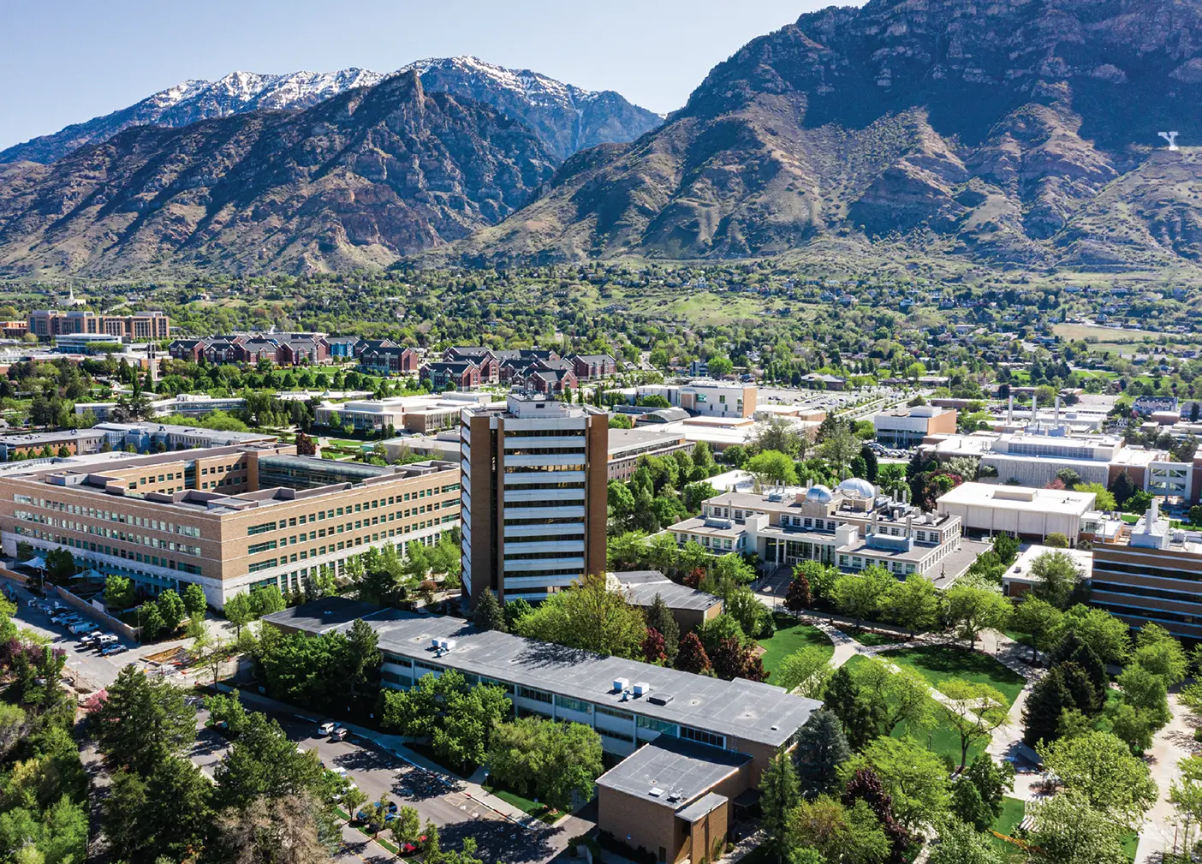

Redefining Success
Strategies to Overcome Perfectionism in College
For President Reese and BYU Staff By: S.E.L.R.
Notes:
Title Ethan

Slide 2
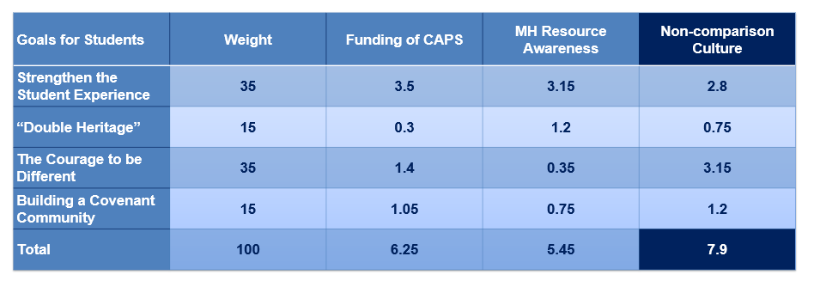
Executive Summary: Problem, Solution, and Matrix
Problem
BYU Aims
Solution
With more societal pressures and the need to be “The Best” at BYU, more and more students are struggling with their mental health.
1. Spiritually Strengthening
2. Intellectually Enlarging
3. Character Building
4. Lifelong Learning and Service
We want to encourage non-comparison culture at BYU, by implementing a two-semester long campaign of mental health awareness and self-acceptance.
Notes:
Sydney

Slide 3



Executive Summary: Timeline & Risks
Campus Wide
Devotionals
Classes
Teacher Stories
Individuals
Art Competition
Free Food
Handouts
Well-being Checks
Surveys
Risks & Mitigations
Discourage
Promoting Failure
Children of God
Two Semester Long Campaign
Outreach
Fall 2025
-Survey
-NSO
-Devotional
-Mental Health Awareness Week
-Finals Week
Winter 2026
-Art Competition
-Reese’s Date Night
-Spring Day
-Finals Week
-Survey
Timeline
Notes:
Sydney Over summer before fall semester start email campaign about all students about new campaign – And awareness about the mental health awareness (NSO)
First devotional given by president and sister Reese about Non Comparision culture
Pass out note cards and stickers with inspirational messages every Friday – Library
Every month free food (doughnuts) with napkins of encouragement.
Every Teacher would need to have one class period where they share a story about them failing, and how they shouldn’t compare to others
Mental Health awareness week – Handing things out, and writing down
Before Finals pass out cookies and hot chocolate about being children of GodD
We have an art competition with a gallery in the Wilk, about inclusion – Cash prizes. This would happen in January
Closing devotional about the inclusion in April
End closing survey enter for a $50.00 gift card Amazon

Slide 4
Our Heavenly Father loves you. He has created you to be successful and to have joy.
-Russell M. Nelson
61%
Of teens say they feel a lot of pressure to get good grades.
-Pew Research Center
Notes:
Our Heavenly Father loves you. He has created you to be successful and to have joy.
Russell M. Nelson

Slide 5

Problem
Solution
Students at BYU are struggling with the poor mental health because of the competitive and perfectionist culture.
We want to increase well-being for BYU students.
Notes:
Problem Problem Statement: Students at BYU often suffer from stress, which we feel fails to live up to the BYU mission statement introduced by President Reese. This is usually due to lack of awareness about mental health resources and a strong culture to succeed in a competitive nature. These issues can detract from the character-building experience BYU strives to give to its students.
Solution Statement: To change our problem of stress, we will look to increase mental health well-being for BYU students. We will do this by encouraging a culture of non-comparison.
RYAN and ETHAN

Slide 6




Agenda
1. Decision Matrix and Alternatives
2. Execution and Timeline
3. Risks and Mitigation
4. Invitation to Action
CANVA CORPORATION
Notes:
Decision matrix: Criteria and weights
Alternatives
Face-to-Face Meetings
Diversity Trainings
Implementation timeline
Risks
Mitigations
Call-to-Action
SYDNEY

Slide 7
Decision Matrix
Goals for Students | Weight | Funding of CAPS | MH Resource Awareness | Non-comparison Culture
Strengthen the Student Experience | 35 | 3.5 | 3.15 | 2.8
“Double Heritage” | 15 | 0.3 | 1.2 | 0.75
The Courage to be Different | 35 | 1.4 | 0.35 | 3.15
Building a Covenant Community | 15 | 1.05 | 0.75 | 1.2
Total | 100 | 6.25 | 5.45 | 7.9
Notes:
Decision Matrix LEO

Slide 8
TIMELINE – 2025 Fall Semester
NSO
(New Student Orientation)
First Devotional
Inspirational Messages
Napkins of Encourage-ment
Teacher Stories
Mental Health Awareness Week
Cookies and Cocoa for Finals
.
CANVA CORPORATION
Notes:
Timeline Implementation
We would imagine a targeted 2-semester-long campaign to really get the point
Over summer before fall semester start email campaign about all students about new campaign – And awareness about the mental health awareness (NSO)
First devotional given by president and sister Reese about Non Comparision culture
Pass out note cards and stickers with inspirational messages every Friday – Library
Every month free food (doughnuts) with napkins of encouragement.
Every Teacher would need to have one class period where they share a story about them failing, and how they shouldn’t compare to others
Mental Health awareness week – Handing things out, and writing down
Before Finals pass out cookies and hot chocolate about being children of God
We have an art competition with a gallery in the Wilk, about inclusion – Cash prizes. This would happen in January
Closing devotional about the inclusion in April
End closing survey enter for a $50.00 gift card Amazon
RYAN

Slide 9
TIMELINE – 2026 Winter Semester
First Devotional
Shane Reese’s Date Night
Art Competition
Inspirational Messages
Napkins of Encourage-ment
Teacher Stories
Chips and Lemonade for Finals
.
**Closing survey for a chance to win $50.00 Gift Card**
CANVA CORPORATION
Notes:
Timeline Implementation
We would imagine a targeted 2-semester-long campaign to really get the point
Over summer before fall semester start email campaign about all students about new campaign – And awareness about the mental health awareness (NSO)
First devotional given by president and sister Reese about Non Comparision culture
Pass out note cards and stickers with inspirational messages every Friday – Library
Every month free food (doughnuts) with napkins of encouragement.
Every Teacher would need to have one class period where they share a story about them failing, and how they shouldn’t compare to others
Mental Health awareness week – Handing things out, and writing down
Before Finals pass out cookies and hot chocolate about being children of God
We have an art competition with a gallery in the Wilk, about inclusion – Cash prizes. This would happen in January
Closing devotional about the inclusion in April
End closing survey enter for a $50.00 gift card Amazon
RYAN

Slide 10
Risks
01 Discouraging other students
02
Promoting Failure
Rebuttals
01
Children of God
02
We are valued and valuable
“Failing is a natural consequence of pushing yourself.”
CANVA CORPORATION
Notes:
We would fear that by accepting and promoting failure, we could discourage those who strive for excellence.
• We would also be promoting failure, which could be seen as promoting the opposite of what universities stand for.
• We would need to mitigate these perceptions by focusing on everyone's divine role as a child of God.
• We would focus on striving and the value of effort & that the Lord will magnify our efforts.
• Really need to focus on the fact that we are all valued and valuable.
• Failing is a natural consequence of pushing yourself.
ETHAN

Slide 11

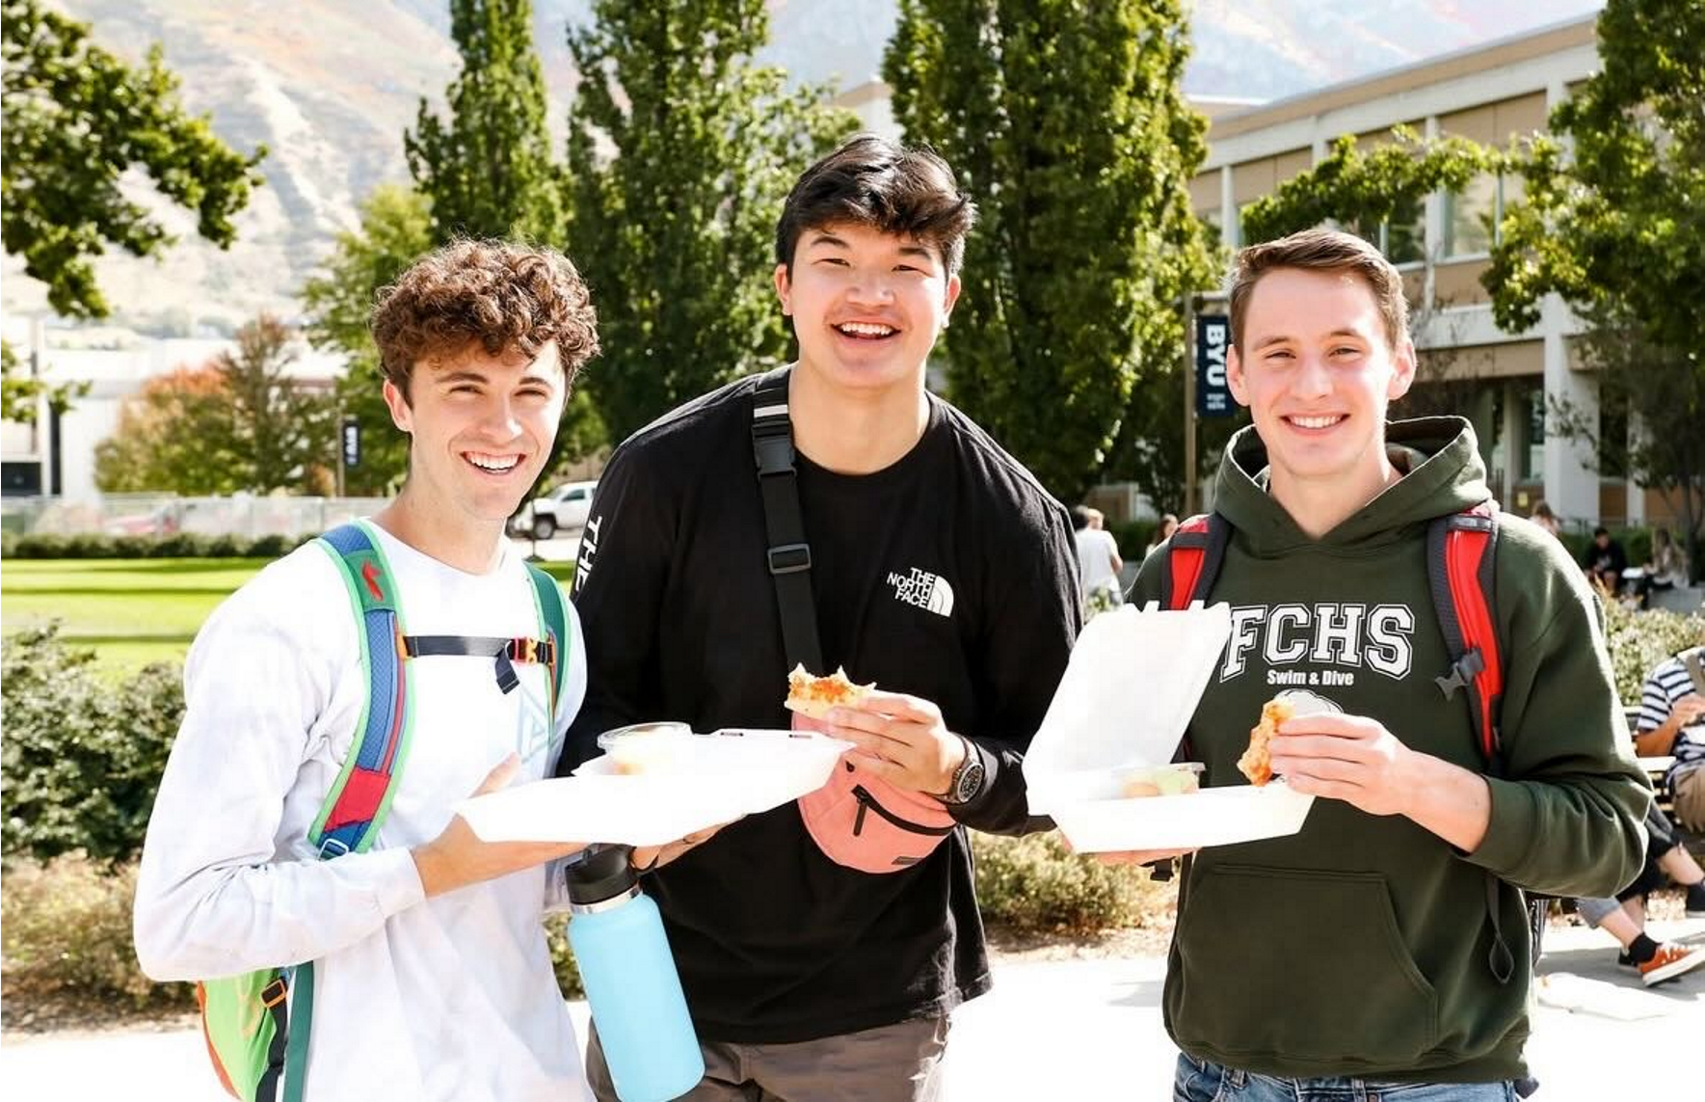
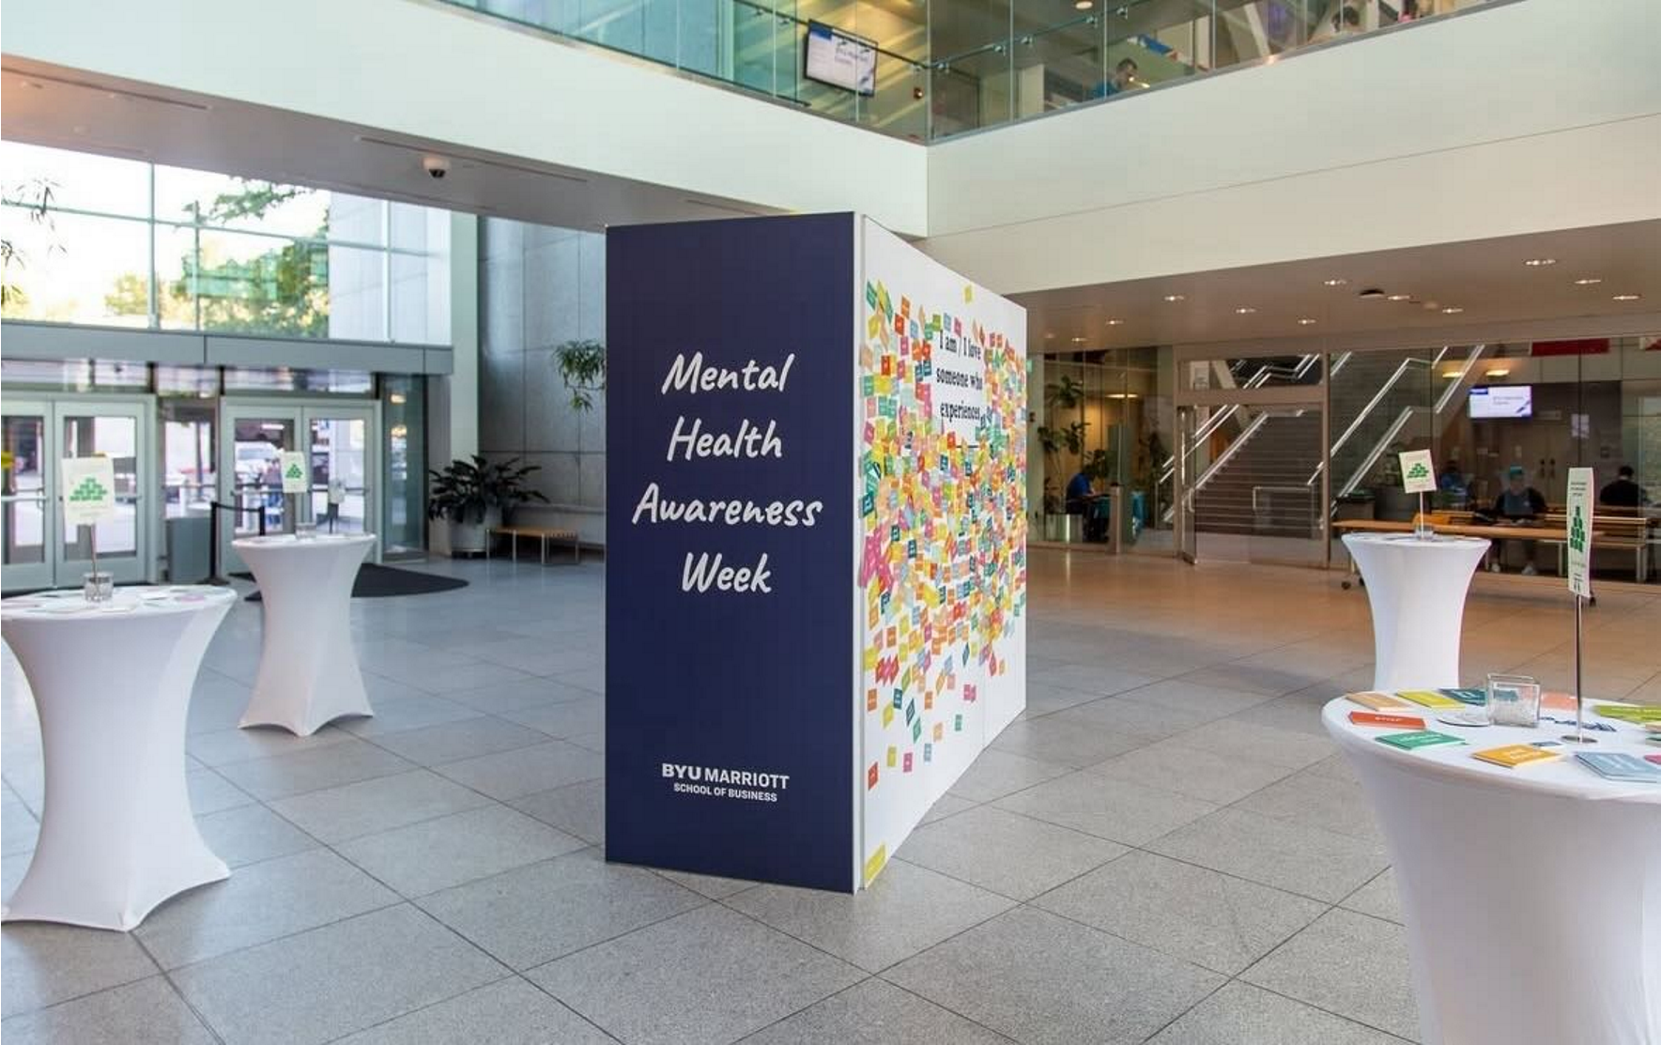
Call to Action
Notes:
SYDNEY
We know that as we all do our part to implement a culture of non-comparison, we can help all students to contribute towards the mission of becoming BYU.

Slide 12
Appendix
How do we avoid embarrassing those who do not want to share their feelings?
How can we invite all students to participate?
In what ways can individual students help solve the problem?
How can we quantify or visualize results of the campaign?
How do we still maintain a rigorous standard at BYU?

Slide 13

How do we avoid embarrassing those who do not want to share their feelings?
Give handouts to everyone and not single anyone out.

Slide 14

How can we invite all students to participate?
encouraging free things and involvement

Slide 15

In what ways can individual students help solve the problem?
They can reach out to CAPS themselves, do their ministering assignments, and remember to prioritize themselves first.

Slide 16

How can we quantify or visualize results of the campaign?
We can track engagement and interactions, as well as note the two surveys.

Slide 17

How do we still maintain a rigorous standard at BYU?
We will not change curriculum but make it easier to ask for help.

Slide 18
Sources
1. https://wellnesswise.byu.edu
2. https://youareloved.byu.edu
3. https://calendar.byu.edu/
4. https://www.pewresearch.org/social-trends

